Slide 1

Introduction to Graph Technologies via Storytelling
…in about 20 minutes
Advanced Technology Collaborative

Slide 2
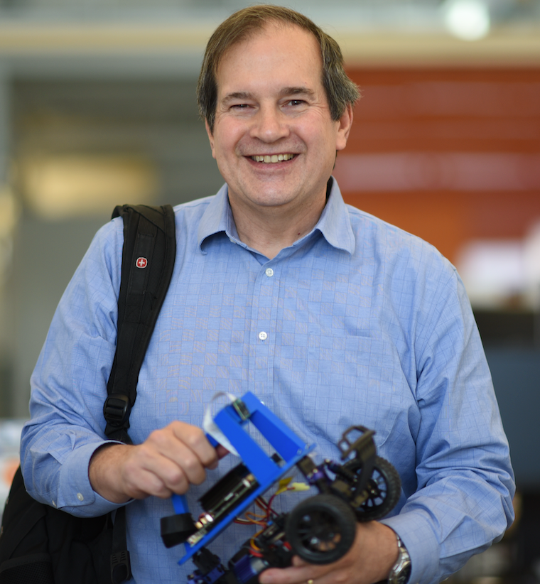
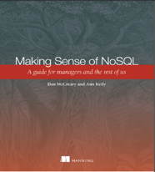
Hello, my name is
Dan
Dan McCreary
Distinguished Engineer
Optum Advanced Technology Collaborative
Coauthor: Making Sense of NoSQL
Solution architecture
Data strategy
AI Racing League
Worked at Bell Labs as a chip designer
Worked with Steve Jobs at NeXT
Research topic: using FPGA to speed graph queries

Slide 3
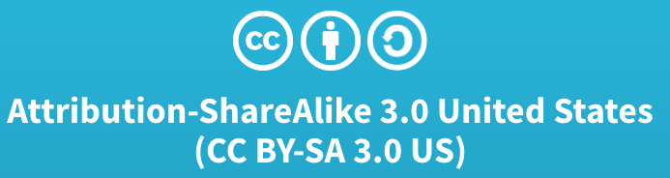
Slides Available
https://github.com/dmccreary/graph-slides

Slide 4
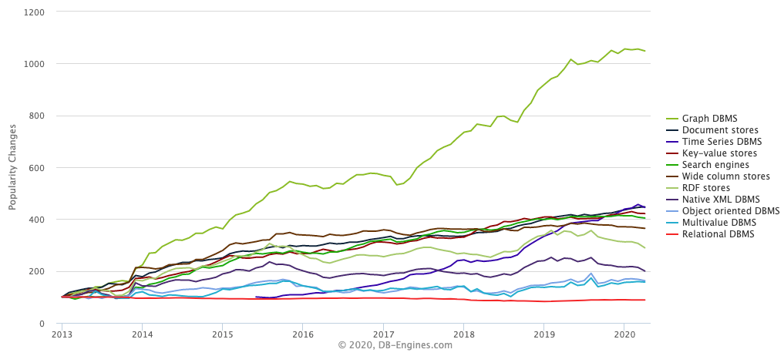
Graph Databases are HOT!
Graph Databases
https://db-engines.com/en/ranking_categories

Slide 5
Six database architectures
Relational
Analytical (OLAP)
Key-Value
key
value
key
value
key
value
key
value
Column-Family
Graph
Document
See Chapter 1: https://www.manning.com/books/making-sense-of-nosql
5
Notes:
There are six main database architecture patterns. Graph is just one of these six – but closely related to documents.

Slide 6
Relational vs. Graph
Relational (row store)
Graph
ID
NAME
DATE
AMOUNT
Atomic unit of storage is a row of a table
Relationships are a secondary concern
Fast rows-by-row access but slow relationships traversal (joins)
Relationships calculated at query time
Atomic unit of storage are nodes and edges
Relationships are a primary concern
Relationship traversal is fast
2M traversed edges per second per core
Relationships are pointers created at load time
Notes:
Lets talking a bit about what a graph database is, and why they have advantages over some of the more familiar relational databases.
When we talk about relation databases, we’re talking about storing information in a tabular form. Technically, this is called a row store because they are highly optimized for storing uniform rows of data. By uniform we mean that every row has the same set of properties with the same datatypes for each of these properties.
If we want to connect that information to another type, such as, office locations, we have to a) hope that connection pathway exists, and b) use JOINs to link them together. As we start to ask more complex questions from our data, and in turn, require more joins, it can become expensive, slow, and operationally complex.
Graphs, on the other hand, take a radically different approach. Instead of rows and columns and tables, information is represented simply as “things” and “relationships”. Things on the graph can, and should be, of a variety of types, e.g. Employee, Location, etc., and the relationships tell us how these things are connected to each other.
Not only do graphs allow us to model our information in a way that better resembles the natural world, but the ability to connect different kinds of information in a graph can be anywhere from 1000 to 1M times faster; drastically reducing the barrier to entry on our complex business questions.

Slide 7
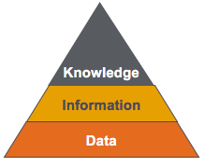

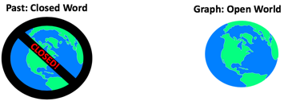
Graph Stories and Metaphors
The Neighborhood Walk
index free agency, performance
The Knowledge Triangle
data, information and knowledge
The Open World Assumption
graph integration, agility
The Jenga Tower
the resilience of graphs to change

Slide 8

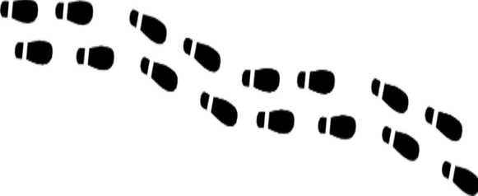
How do you get to your neighbor’s house?
You walk out your door, point to house, walk directly to the house
Your houses are “Adjacent” so getting there is a direct “hop”
You don’t need to consult anyone else about how to get to a neighbor’s house because you have the right pointer
Relationships pointers are created at data load time, not at query time
Walk time: 30 seconds
Notes:
Sometimes the best way to understand how graph databases are different is using a metaphor. We call this metaphor the “Neighbor Walk” metaphor. It has proven very helpful for people that are trying to understand the performance differences between relational joins and a graph traversal.
Let’s say you want to walk out your front door and over to your neighbor’s house. You open the door, point you body to the neighbor’s house and walk over there. Pretty simple. Since your houses are adjacent this is the logical way to do it.

Slide 9
Logical Graph Model
NEIGHBOR_OF
Dan
Ann
If two physical items are related, they have a relationships arc between them, and we model it like the above
We build a “logical” data model that has this link
In a native graph, the vertexes are loaded into memory and then the physical memory addresses of each link is also reflected in each of the nodes
Notes:
Here is the graph “logical model” for this. You might have a vertex for your house, a relationships called LIVES_NEXT_TO as a pre-calculated relationship to your neighbor’s house.

Slide 10


Relational Database Use Indexes
Central
Index
Search: 123 Main St.
You must walk to a central index system
The index system does a “search” given the house’s address
The index system will tell you how to get to your neighbor's house
1,000x slower
Walk time: 8.3 hours
Notes:
Here are the steps that are reflective of how a relational databases does joins
Walk out the door
Walk downtown to the DMV where they have a service that tells you how to get to your neighbor’s house
When you get to the DMV you take a number
When your number comes up you get called by a search agent
You give your neighbors name to the DMV search agent
The search agent at the DMV has a list of all the people in your town sorted by their address (called the index). They search the list (using a binary search algorithm) and they finally give you the GPS coordinates of your neighbor’s house.
You take these GPS coordinates, enter them them into your GPS tracker and follow the directions to Ann’s house.
Now granted the metaphor is not perfect. The speedup really depends on how many rows each table has. However, this metaphore helps you remember that sometimes directly addressing a memory location that is pre-calculated for you at load time can sometimes be three orders of magnitude faster than searching for something every time you need to access it. RDBMS systems try to minimize this search time by doing clever things like caching. However the more data you have the longer the searches take. Direct memory access will always be faster than doing a search!
Now lets also look at some different architectures than a single node graph.

Slide 11
Graphs and the “Open World” Assumption
Past: Closed Word
Graph: Open World
CLOSED!
Everything is prohibited until it is permitted
You can only add data that you model
Everything is permitted until it is prohibited
Anyone can easily add any data at any time without disruption of services
Notes:
http://www.mkbergman.com/852/the-open-world-assumption-elephant-in-the-room/

Slide 12
The Knowledge Triangle
Diagram for representing the relationships between data, information, and knowledge
Too often we focus on “Big Data” and not enough on connected knowledge and transferrable knowledge
Graphs are connected information concepts
Wisdom is reusable across multiple context
Can we capture knowledge in a form that can be reused across multiple domains?
Knowledge
Patterns Relationships
Information - Concepts
Data - Binary, Codes, Data Lakes
https://en.wikipedia.org/wiki/DIKW_pyramid
Notes:
Now lets take a look into some of the reasons that organizations are moving toward knowledge graphs as ways to connect and reuse data. The structure we used to describe this system is called the Knowledge Triangle or sometimes the DIKW Pyramid. It is a triangle with Data at the bottom, Information at one level up, connected Knowledge (in the form of a graph) at the third level and Wisdom at the top.
In most systems, Data comes from external sources the form if low-level binary and numeric codes. For example this might be a table-by-table dump from a RDBMS system into a set of CSV files. However, the metadata that describes these codes is often not transmitted with the data. So it is difficult to figure out what the codes mean. At the Data level it is expensive and time consuming to find the meaning of data. We call this semantically poor data.
Some information might be stored at a higher level – we call this the Information level. At this level we clearly identify the nouns in the data. We find the people, places and things. But these things may not be connected together.
JSON and XML files are good choices to transmit information because they send labels with the data.
The next higher level is the Knowledge level. Knowledge is Information that is put in the right context – it is connected to other concepts. The Knowledge level allows us to focus on large patterns that stretch across multiple domains. We can move between Providers, Claims, Services and Members by doing queries over our graph.
The Wisdom is the layer most strongly associated with AI. When we think of going to the top of the mountain and we ask the Gurus for advice, we are asking them to apply their knowledge to our specific problem. We are asking them to transfer knowledge to our context.

Slide 13
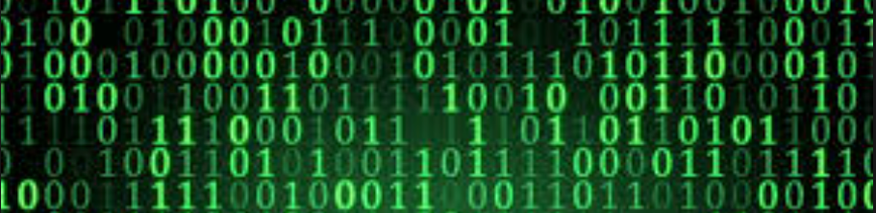
From Raw Data to Wisdom
Knowledge can be reused across multiple context
Reusable?
Connections
De-duplicated
Knowledge
Graph
Continuous
Enrichment
Consistent
Machine Learning
Tagged Text
Concepts
Validity
Information
Semantics
Defintions
Searchable
Raw data dumped from a database, log files or documents
Data Lake

Slide 14
Our Brains are Graphs
84B neurons
10K Connections per neuron (degree)
Notes:
Be careful how you use brain metaphors. The brain has a much different architecture than an enterprise knowledge graph. The degree of a EKG is typically around 10, not 10,000. Relationships in the brain are active and both enrich and suppress signals between neurons.

Slide 15
The Jenga Tower
How do small changes in the model impact your queries and reports?

Slide 16
How does a small change impact the stability of your queries?
1,000 SQL or SPARQL queries that need to be changed
We need to add one new property to this relationship
What is the blast radius?
How do we prevent one small change in our model from disrupting 10,000 queries and reports?
Why are labeled property graphs more flexible than relational and RDF models?

Slide 17
When to use a graph database
A Taxonomy of Graph Use Cases
Notes:
https://medium.com/@dmccreary/a-taxonomy-of-graph-use-cases-2ba34618cf78

Slide 18
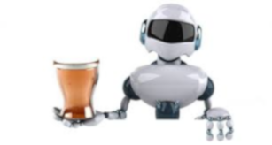
The Deep Learning Bartender
Can I Recommended a Drink?

Slide 19

Explainable AI Models are Graphs
Traditional ML Only
Task
Why did you do that?
Why not something else?
When do you succeed?
When do you fail?
When can I trust you?
How to I correct and error?
Training
Data
Machine
Learning
Process
Learned
Function
Decision or Recommendation
Explainable AI
Task
I understand why
I understand why not
I know when you succeed
I know when you fail
I know when to trust you
I know why you erred
Training
Data
New
Machine
Learning
Process
Explanation
Interface
Explainable Model
https://www.darpa.mil/program/explainable-artificial-intelligence
Notes:
Explainable AI is a key
https://www.darpa.mil/program/explainable-artificial-intelligence

Slide 20
What is the Value of Connected Data?
Customer
Product
Purchase
Review
Survey
What products should we recommend to our customers?

Slide 21
NLP Processed Documents are Graphs
THIS SERVICES AGREEMENT (this "Agreement"), effective as of March 15, 2018 (the "Effective Date"), is entered into by and between Acme Services, Inc. ("Company") and United HealthCare Services, Inc., for the purpose of setting forth the terms and conditions under which Company will provide certain services to United HealthCare Services, Inc. and its Affiliates (collectively, "UHS"). As used herein, "Affiliate" means any entity directly or indirectly controlled by, controlling, or under common control with United HealthCare Services, Inc. Any Affiliate may receive Services (as defined below) under this Agreement.
type=date
Effective Date
March 15 2018
type=company
Contract
Service Provider
Acme Services Inc.
type=company
Service Consumer
United HealthCare
relationships
Facts can be extracted directly from text documents and placed into a graphs

Slide 22
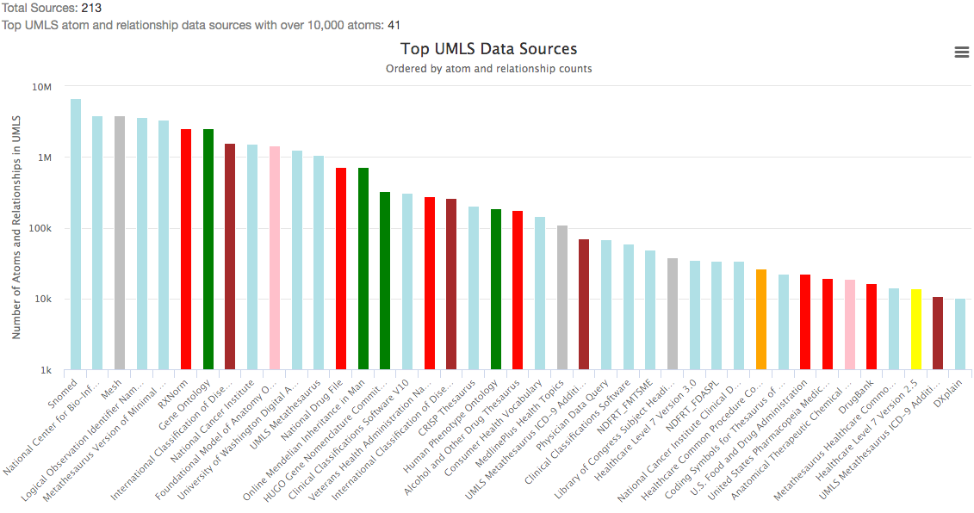
Medical Vocabularies are Graphs (UMLS)
Gene
Drug
Publishing
Anatomy
Diagnosis Coding
Integration
Procedures
Notes:
UMLS – Unified Medical Language System

Slide 23
Sample Graph Traversal Patterns
Dependencies
Failure chains
Order of operations
Clustering
Finding related items
Friends, fraud networks
Similarity
Similar paths and patterns
API
Server
Auth
Data
Matching/Categorizing
Look for and tag specific patterns
Flow/Cost
Optimize costs based on routing
Path optimization
Centrality/Search
Which nodes are the most connected or relevant?
Notes:
Dan

Slide 24
Suggested Research Topics
Explainable AI using concept graphs
Graph Convolutional Neural Networks - GCN
Graph2vec – conversion of nodes into vectors for fast comparison
Parallel hardware for executing graph algorithms
Combination of symbolic reasoning and machine learning

Slide 25



Thank You
Questions:
Dan McCreary – Dan.McCreary@gmail.com
Slides: https://github.com/dmccreary/graph-slides
https://www.linkedin.com/in/danmccreary
https://medium.com/@dmccreary
@dmccreary

